Slide 1
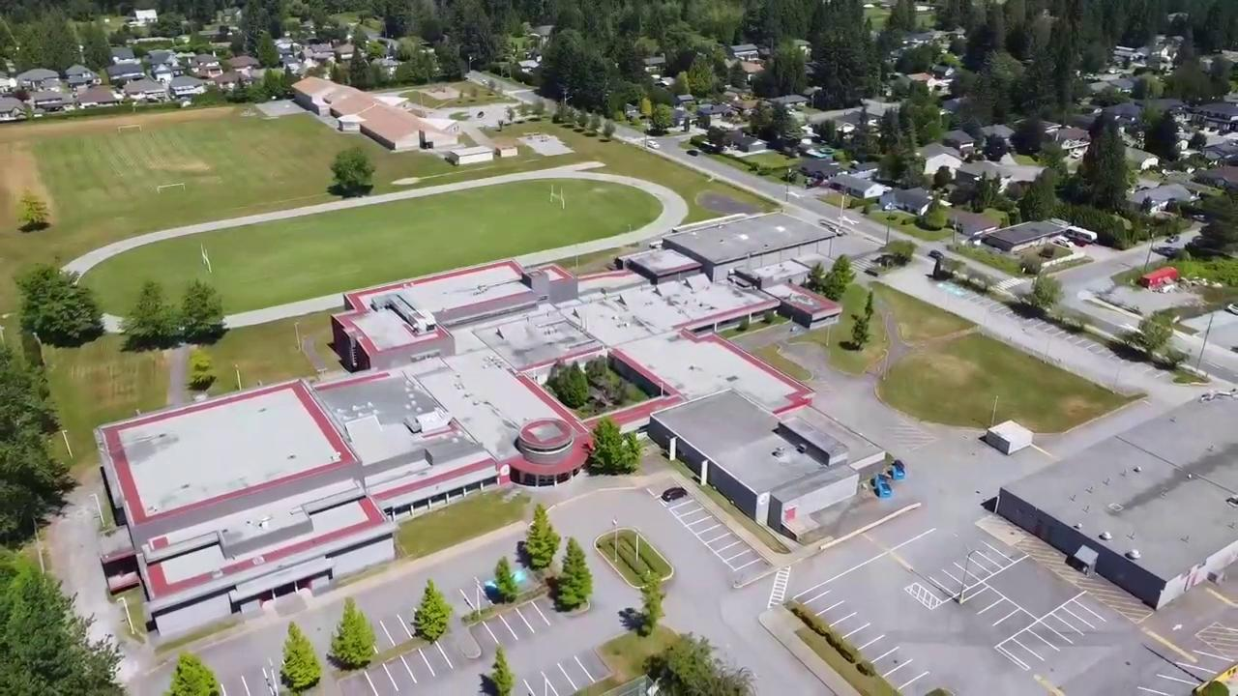




Garibaldi Secondary
International Baccalaureate
Programme
About GSS

Slide 2
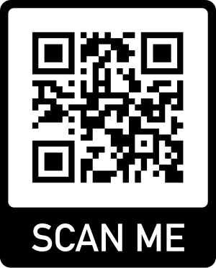
Garibaldi Secondary
International Baccalaureate
Diploma Programme
Information Night

Slide 3
Garibaldi Secondary
International Baccalaureate
Diploma Programme
International Baccalaureate
Diploma Programme
Information Night
Jan 28 2026
7PM - GSS LIbrary
Information Night

Slide 4
Garibaldi Secondary School
Gr 11 and 12
IB Diploma Programme
Parent Info Night
GSS Library - 7 PM
Approx one hour
Information Night

Slide 5
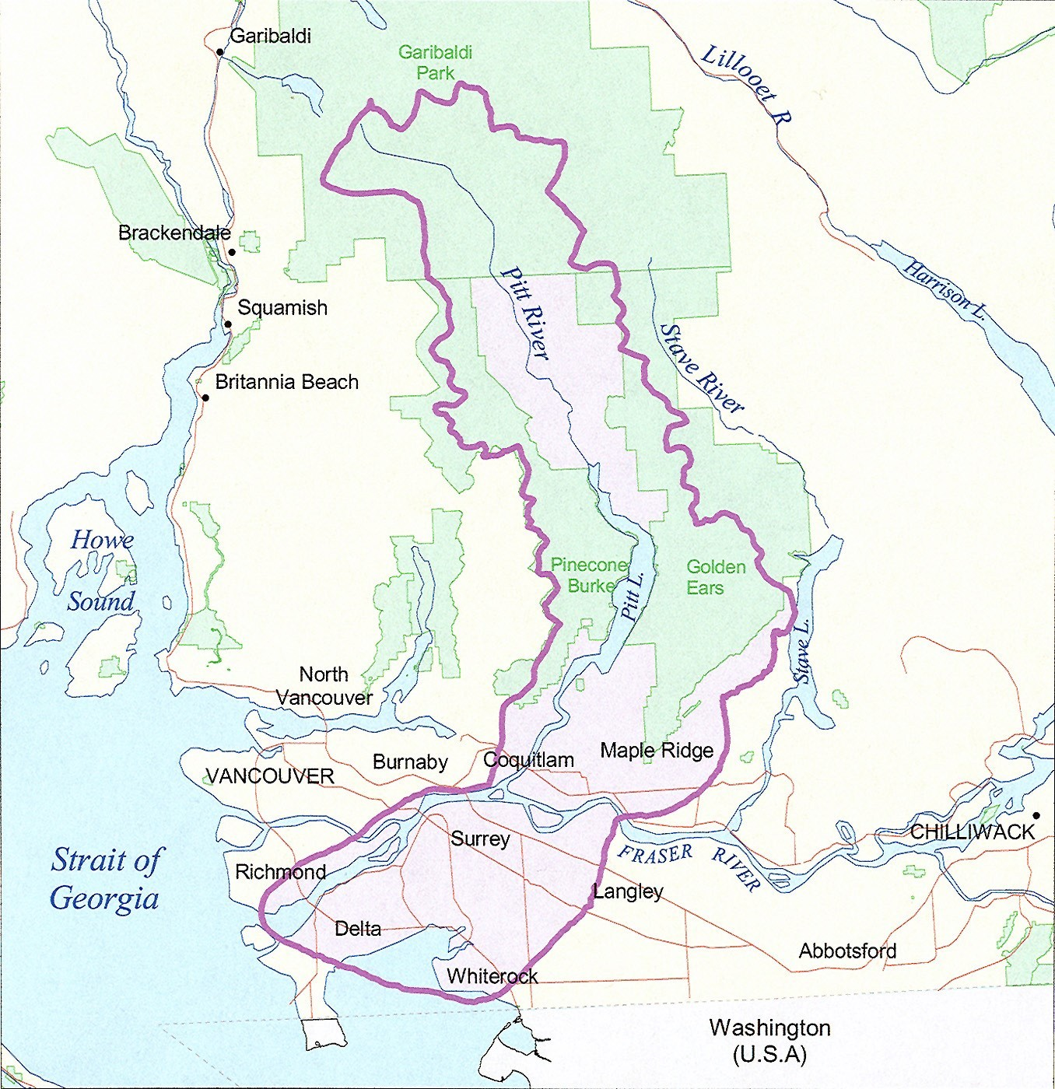
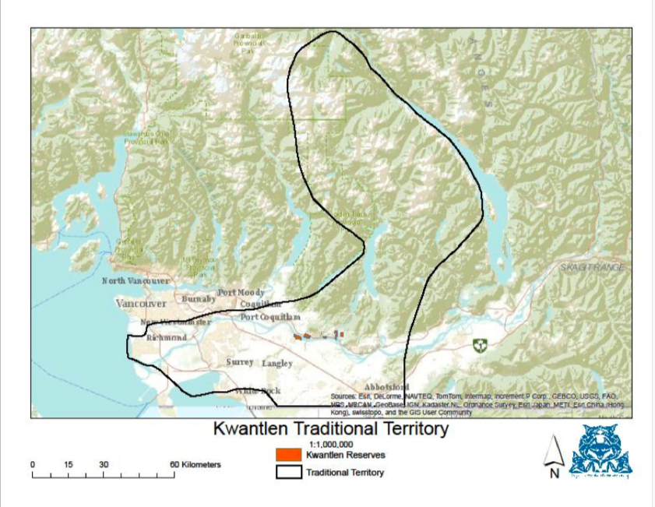
I would like to acknowledge that we are having this meeting on the shared traditional and unceded territories of Katzie First Nation and Kwantlen First Nation.
I also welcome and recognize all of our First Nations, Métis, and Inuit students and families in our schools and community.
As well, I want to welcome and recognize the many different cultures that are represented in our schools and community.
About GSS

Slide 6
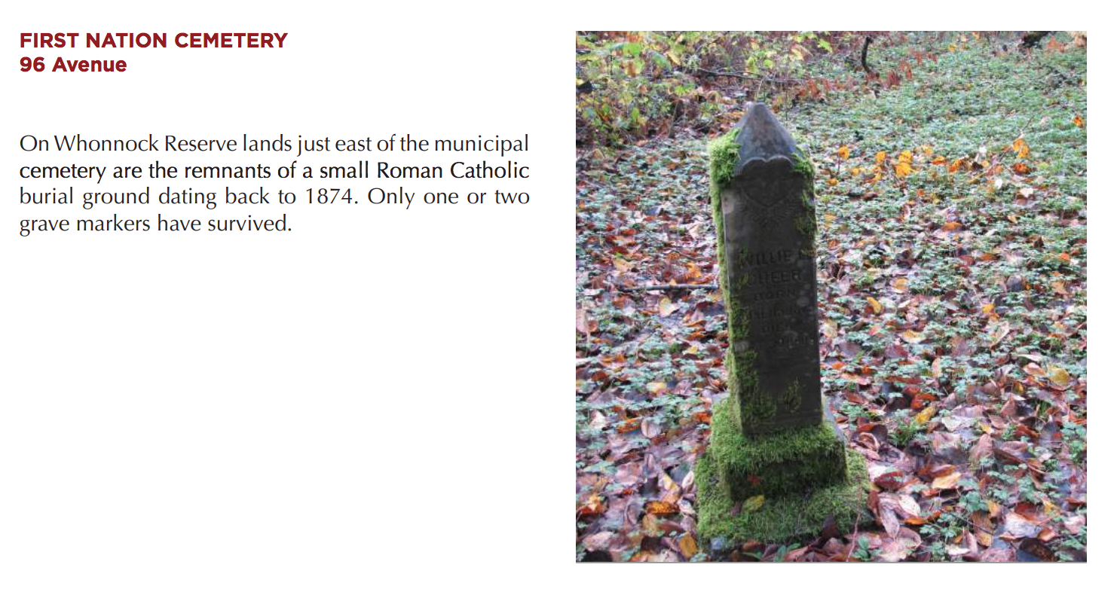
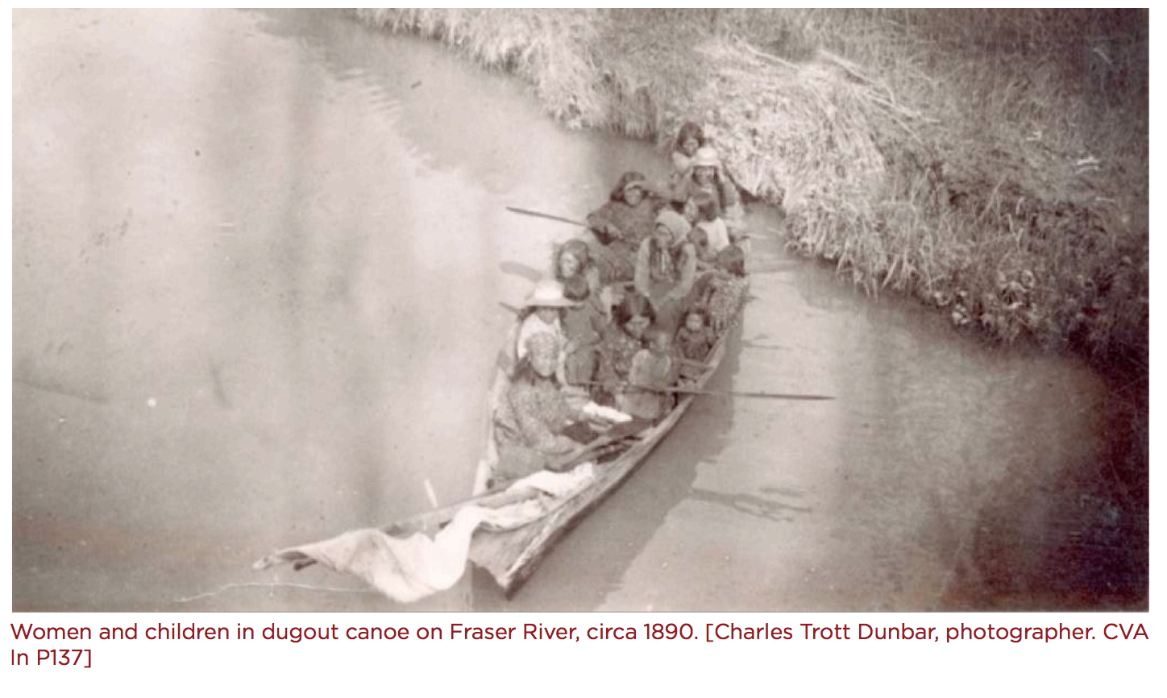
First
People
About GSS

Slide 7
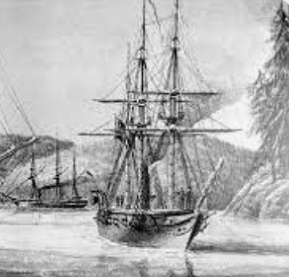
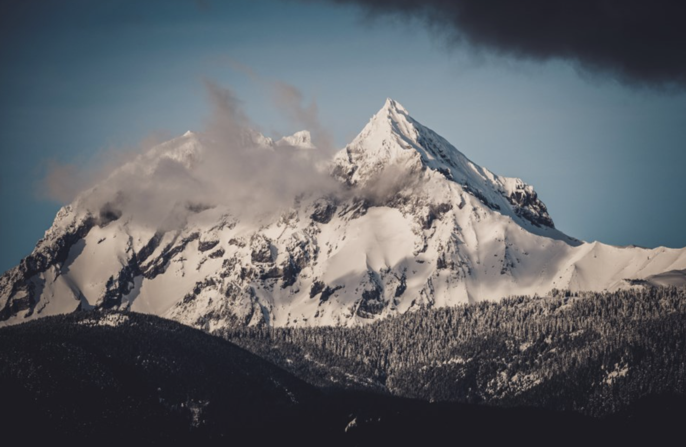
The
The Nch’ḵay̓ and a Boat
About GSS

Slide 8
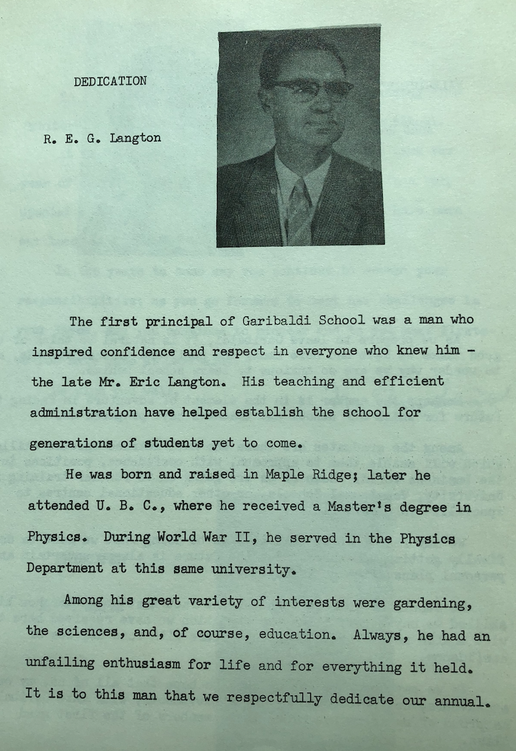
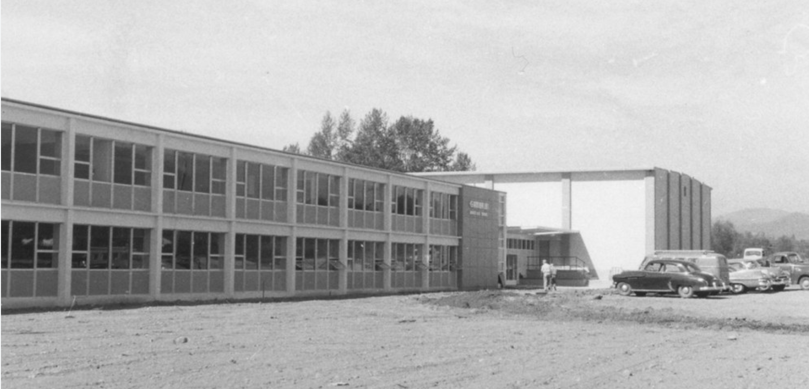
Garibaldi History
About GSS

Slide 9
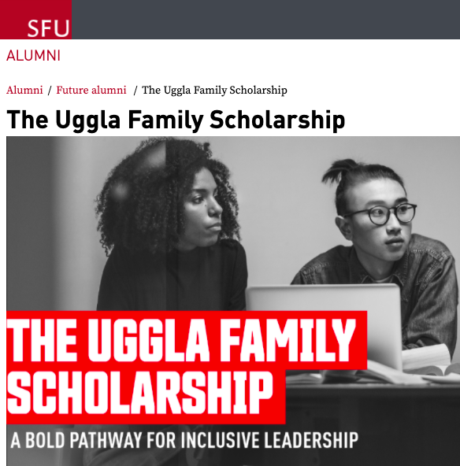
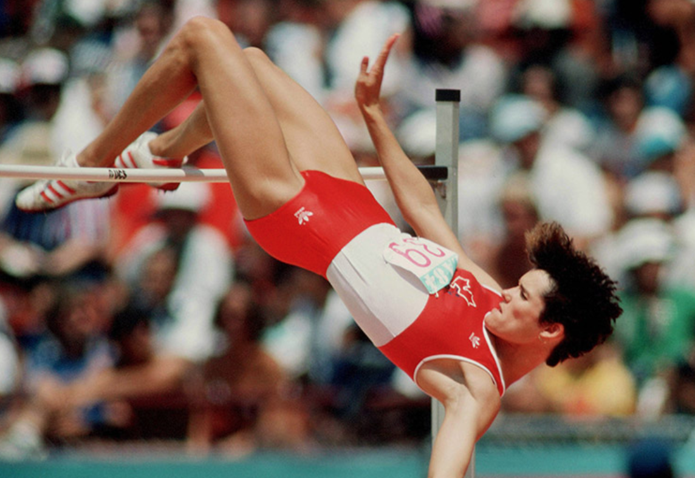



Garibaldi
Grads
About GSS

Slide 10

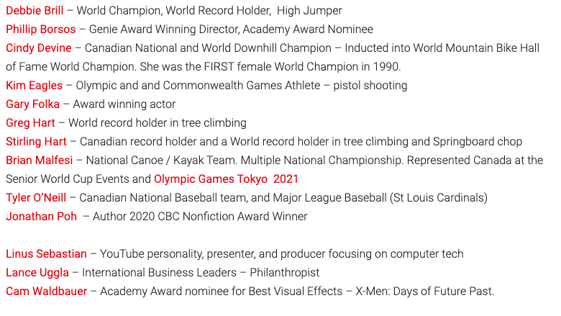

About GSS

Slide 11






About GSS

Slide 12
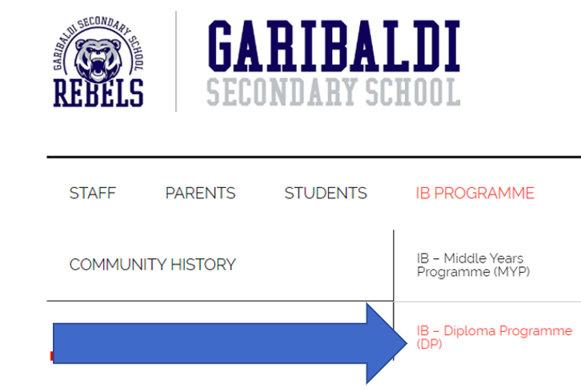
IB Diploma Programme Website
All information from today is accessible on our IB DP website:
https://gssib.sd42.ca/
Linked on our GSS website under Top tab IB Programme, sub tab IB - DP Programme (DP)

Slide 13
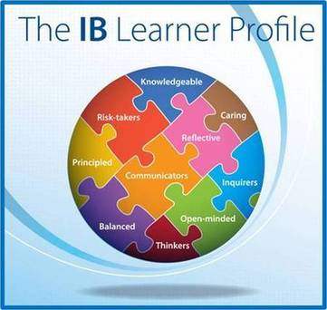
Why IB?
•An enriched approach to education that challenges our students to immerse themselves in their learning
•Preparation for academic life after high school – we continually hear that our IB students are successful and ready for the realities of University
•The IB DP goes beyond academic learning, develops well-rounded students with creative and critical thinking skills, ethical decision-making and a passion for inquiry and learning.

Slide 14
MYP to DP Continuum
Although there is no pre-requisite to study the DP, the IB’s Middle Years Programme (MYP) does align closely with the DP, ensuring a smooth transition for students.
MYP’s focus on approaches to learning continues through to the DP.
MYP prepares students for the DP by reflecting the depth, breadth and balance that is characteristic of all IB programmes
Students benefit from consistent and shared approaches to teaching of the MYP and DP

Slide 15
Why IB?
•Community building – students and teachers spend their time constructively supporting each other and continuously learning - a “School within a School”
•Today’s world is increasingly global, and IB places developing an international perspective at its core
•Students are encouraged and expected to be active and engaged citizens - both locally and globally.
Education for a better world

Slide 16
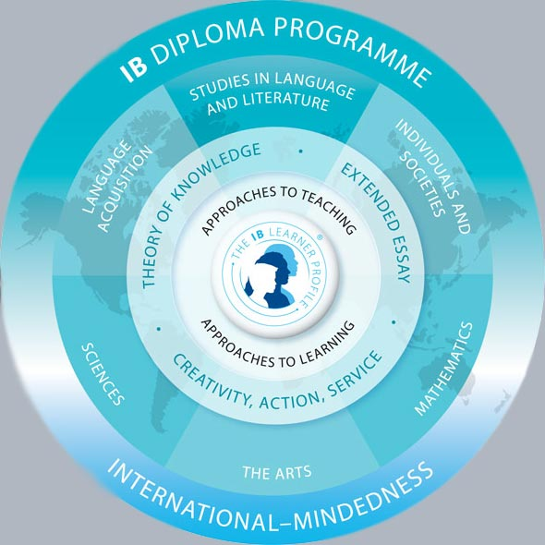
IB DP Curriculum Framework
Students take 6 subject area courses along with the Core over 2 years
Students need 3 Higher Level (HL) and 3 Standard Level (SL) courses
The Core consists of:
Creativity, Action and Service (CAS)
Theory of Knowledge (TOK)
Extended Essay (EE)
Notes:
To Colin

Slide 17
HL vs. SL
Higher Level courses require more instructional hours and generally cover more topics than Standard Level courses.
The curriculum covered is not necessarily harder

Slide 18

IB Core - Theory of Knowledge
Dedicated course in student's schedule
Explores how we know what we know - the nature of knowledge across disciplines
Fosters a global perspective
It demonstrates the ways in which the student can apply their knowledge with greater awareness and credibility
Notes:
Kyle

Slide 19
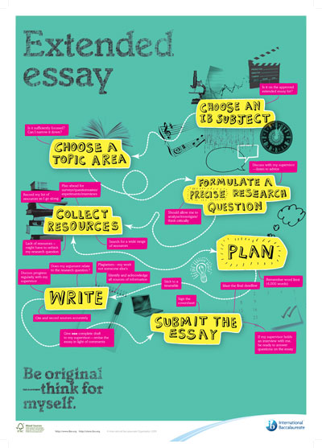
IB Core - Extended Essay
Independent, self-directed piece of research ending with a 4,000 word paper
Practical preparation for undergraduate research
Highly supported by Garibaldi teachers and teacher-librarians
Additional “points” for final Diploma
Notes:
Added another slide at the end that could go right after this slide. It is a sample set of 3 essay topics from GSS students.

Slide 20
IB Extended Essay GSS Student Examples
Something in the Way: How did Nirvana, a Seattle based Grunge rock band, help support, change and create Third-Wave Feminism?
To what extent should adolescents be concerned about the effects of digital technology on the brain’s structure and cognitive development, with a focus on memory and attention span?
Manipulating Nature: How and why has the management of ecosystems in Kruger National Park through the provision of artificial water changed over time?

Slide 21
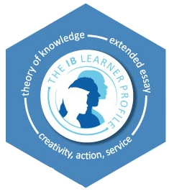
IB Core - Creativity, Activity and Service
Students make a plan in Grade 11 to incorporate all three components in their Grade 11 and 12 year
CAS is not formally assessed but is a required component of the Diploma Programme
Information and support for completing CAS is delivered during the TOK class

Slide 22
Courses offered at Garibaldi
Group 1
MANDATORY
English HL
Group 2
MANDATORY
French SL
French Ab Initio
SSST - home language
Group 3
CHOOSE 1
History HL Business HL/SL Philosophy HL/SL
Group 4
CHOOSE 1
Biology HL/SL Chemistry SL Computer Science HL/SL
Group 5
MANDATORY
Math SL
Group 6
CHOOSE 1 or 2nd Course from Group 3 or 4 Visual Art HL/SL
Music HL/SL
Core
MANDATORY
TOK/EE
CAS

Slide 23
Science Focus
Course 1
English HL
Course 2
French SL
Course 3
History HL
Course 4
Biology HL
Course 5
Math SL
Course 6
Chemistry SL
Course 7
Core
TOK/EE
CAS
Course 8
Ministry Courses
Physics 11/12

Slide 24
Humanities Focus
Course 1
English HL
Course 2
French SL
Course 3
History HL
Course 4
Biology HL/SL
Course 5
Math SL
Course 6
CHOOSE 1
Visual Art HL/SL, Music HL/SL, Business HL/SL, Philosophy HL
Course 7
Core:
TOK/EE
CAS
Course 8
Ministry Courses
Room in timetable for 1 more course

Slide 25
Hybrid Schedule
Course 1
English HL
Course 2
French SL
Course 3
Business* HL
Course 4
Biology HL
Course 5
Math SL
Course 6
CHOOSE 1
Chemistry SL Comp Sci SL/HL History SL/HL
Course 7
Core:
TOK/EE
CAS
Course 8
Ministry Courses
Room in timetable for 1 more course
Does not fulfill BC Ministry Social Studies credit (it’s an ADST course). Students must complete SS credit through IB History, IB Philosophy, or a non-IB SS course.

Slide 26
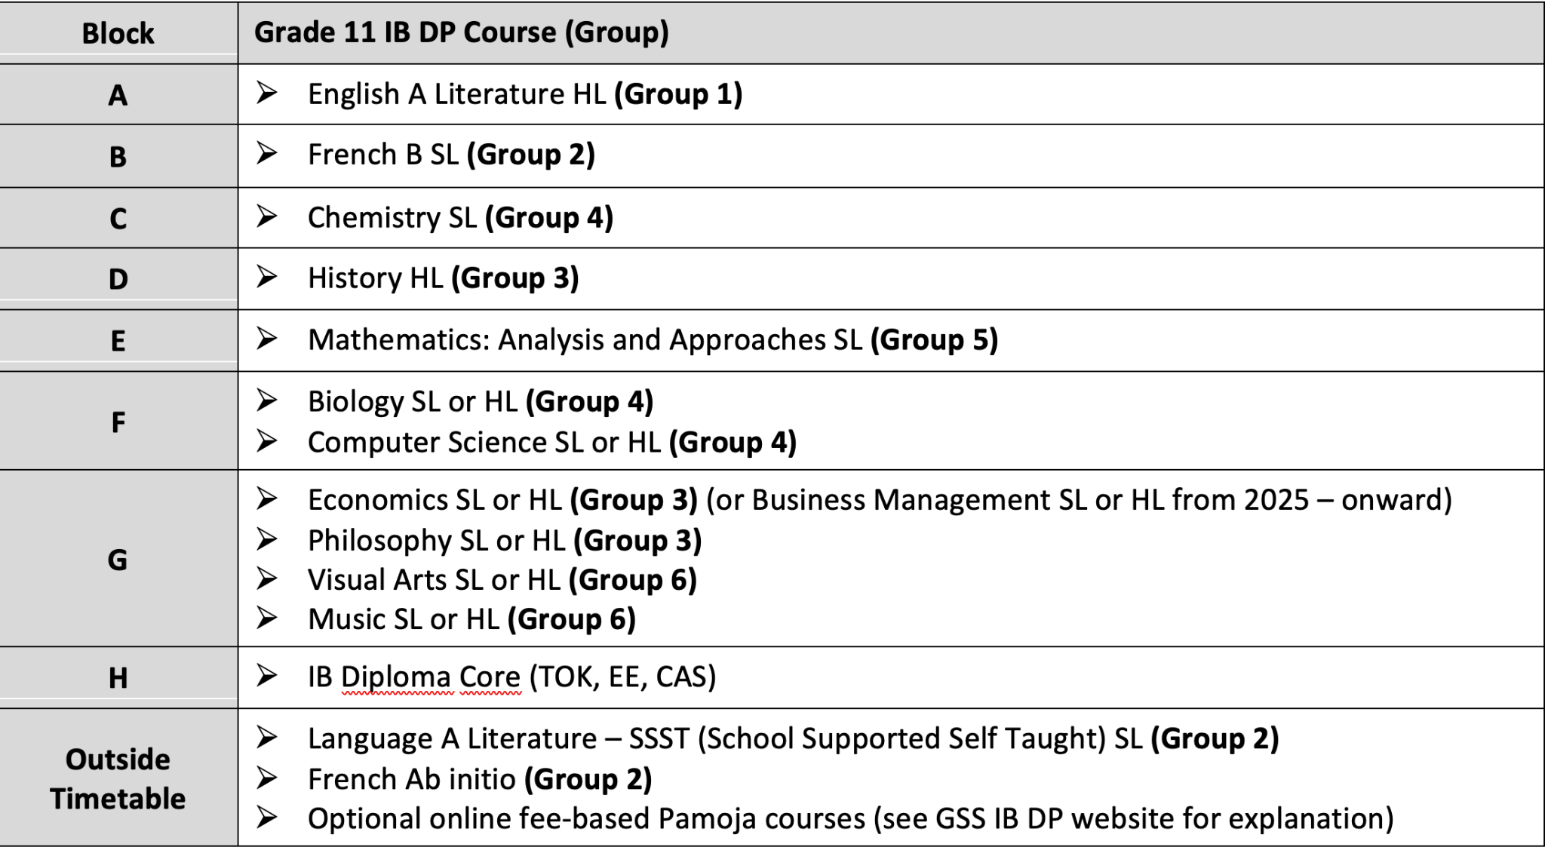

Slide 27
SSST - Language A Support - Ms. Elphick
School-Supported Self-Taught
Replaces French B for students whose mother-tongue is not English
Allows students to earn Language A in their mother-tongue and a Bilingual Diploma
With support from a teacher students use Moodle to access an online course that has their material in their home language

Slide 28
French Ab Initio
Ab Initio is for students who have never studied French before. In timetable goal for 2025
Replaces French B for students who may have studied a language we do not offer, but still want the in-class experience
Depending on enrollment, is taught as a cohort within a FSL course over 2 years, or can be a stand alone course

Slide 29
Assessment in IB
The IB Diploma has a maximum of 45 points - each course is marked on a scale of 1(low) - 7 (high)
42 points are determined through the 6 subject area courses and 3 additional points through the Core (TOK and EE)
Minimum 24 points are needed for the Diploma to be awarded
Final marks are released in July of Grade 12 after all IB Final Exams are externally marked
Exams are in May of Gr. 12 year

Slide 30
GSS results compared
GSS top score = 43 (2021)
2024 results statistics
*these numbers are smaller than average
 | Worldwide | GSS
Average diploma score | 30.3 | 32
Average score per course | 4.9 | 5
# of candidates | Approx. 192,000 (121,000 diploma) | 31 (10 diploma*, including 1 bilingual diploma*)

Slide 31


IB SL Assessment - Conversion Scale
7
6
5
4
3
96%
90%
86%
76%
70%
A
A
A
B
C+
Notes:
https://www.sfu.ca/students/admission/admission-requirements/international-baccalaureate.html
http://www.calendar.ubc.ca/vancouver/?tree=2,279,0,0

Slide 32
IB HL Assessment - Conversion Scale
7
6
5
4
3
98%
96%
90%
86%
76%
A
A
A
A
B
Notes:
https://www.sfu.ca/students/admission/admission-requirements/international-baccalaureate.html
http://www.calendar.ubc.ca/vancouver/?tree=2,279,0,0

Slide 33
IB Internal Assessments (IA) GSS student examples
Philosophy - Is the soul immortal?
Math - Finding and representing data for a zombie apocalypse.
History - Were Soviet filmmakers under Stalin driven by artistic incentive or political ideology in creating films?
Biology - Does the angle of your arm in paddling change your grip strength?
Notes:
Helen

Slide 34
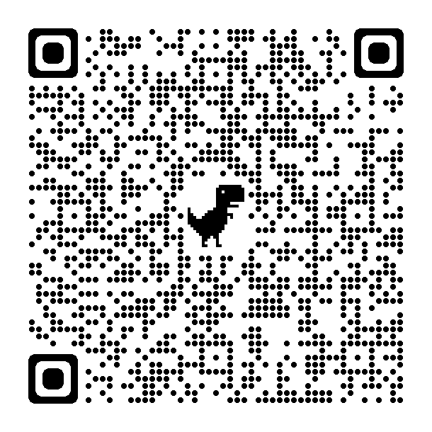
Post Secondary and IB
Universities access IB Diploma marks via the IB secure website.
IB is recognized in 150+ countries and 2,000 universities worldwide, but admissions policies vary—conducting your own research is key.
Some universities offer scholarships or first-year credit for IB Diploma courses, but rules differ by institution.
Check how institutions recognize IB here:
https://recognition.ibo.org/

Slide 35
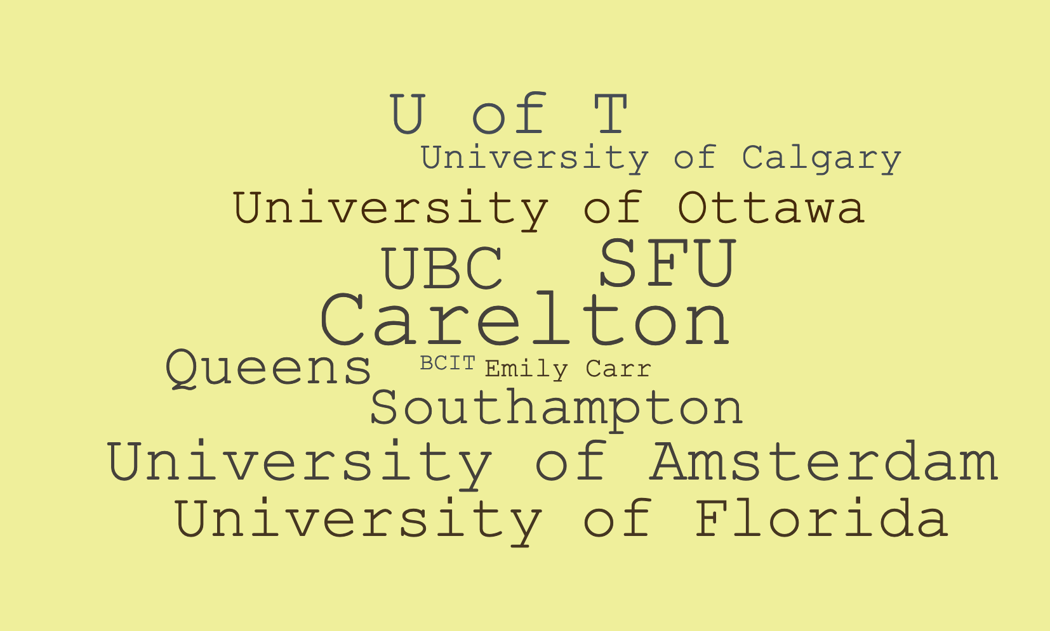
Where recent grads are studying now.

Slide 36
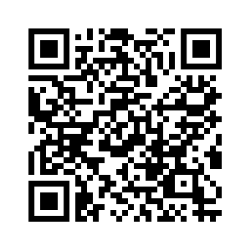
Key findings from IB research
2022 UBC/UofT study shows that, when compared to Dogwood and French Immersion students, IB students:
are more likely to complete their degrees (less likely to drop out of university)
have a higher GPA throughout their undergraduate program
are more likely to participate in co-op programs
are more likely to enter STEM fields
Results of this and other studies found here: https://www.ibo.org/research/outcomes-research/diploma-studies/
Completing the IB guards against “academic shock” (UBC Admissions Presentation, 2024)

Slide 37
Certificate Courses
Students who do not want to take the full Diploma Programme can opt for taking single or multiple courses
It is recommended that Certificate courses are taken as HL when possible in order to have the best chances of receiving first year credit at post secondary institutions

Slide 38
Diverse learners
Students with IEPs have access to exam accommodations, including:
Extra time
Use of word processor
Access to spell checker
Use of four function calculator
Paperwork (Psych Ed Assessment, IEP, etc) must be submitted to and approved by the IBO.
In school accommodations are also provided to students with IEPs.

Slide 39
IB Fees
Students enrolled in the full Diploma:
$600 per year (totalling $1200)
For students taking Certificate courses only:
$120/ Certificate course (1 time cost of the exams)
The School District funds the majority of the cost associated with running the Diploma Programme
For families, the cost for IB can be offset by tuition fees saved at post secondary

Slide 40
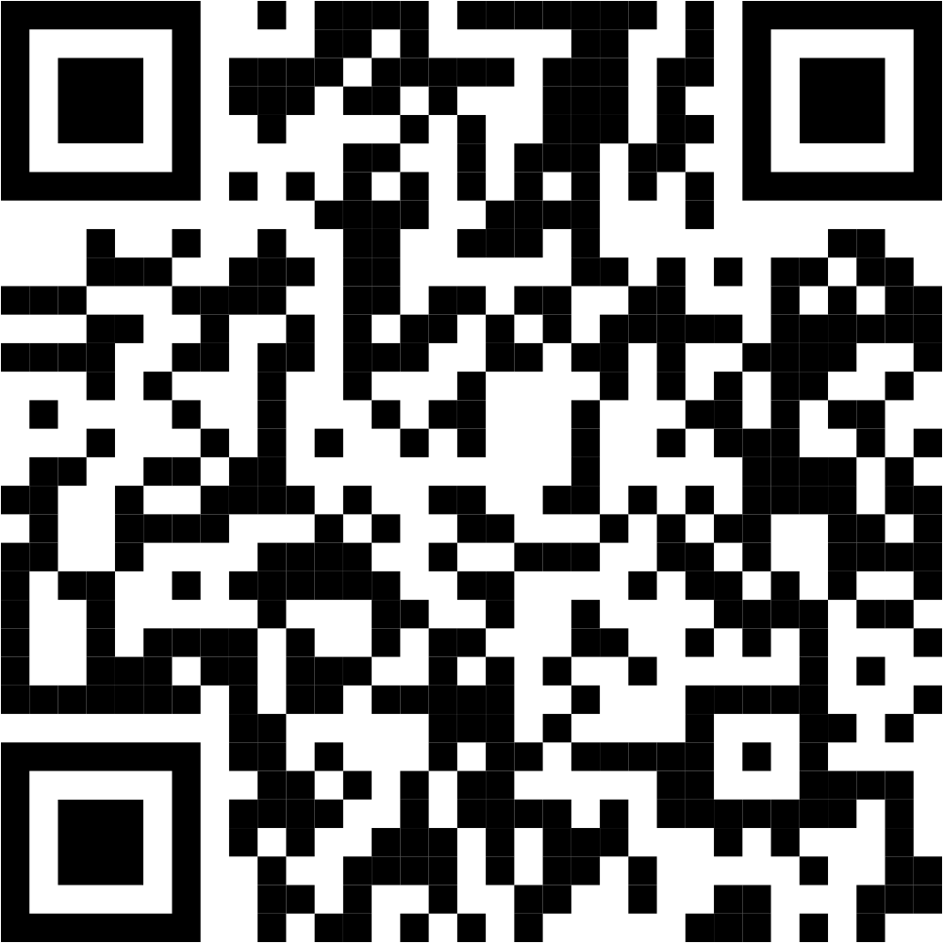
Deadlines
Applications can be submitted anytime before Spring Break.
Recommended score of 3 on provincial assessments, and teacher recommendation. All applications considered.
Application forms found here:
https://gssib.sd42.ca/apply/
Notes:
Assunta

Slide 41
IB Coordinators
Kyle Ludeman - IB DP History, TOK, CAS and IB DP Coordinator
Pauline Lemieux - Academic Advisor until June 2025 , IB DP Advisor
Ian Liversidge - Principal

Slide 42
Questions?
There are IB teachers here this evening to answer questions.
www.ibo.org is the IB website, which has all the information on the Diploma Programme
Please feel free to email the IB Coordinator, Mr. Ludeman, at Kyle_Ludeman@sd42.ca
Call the school and arrange a meeting with Ian_Liversidge@sd42.ca

Slide 43
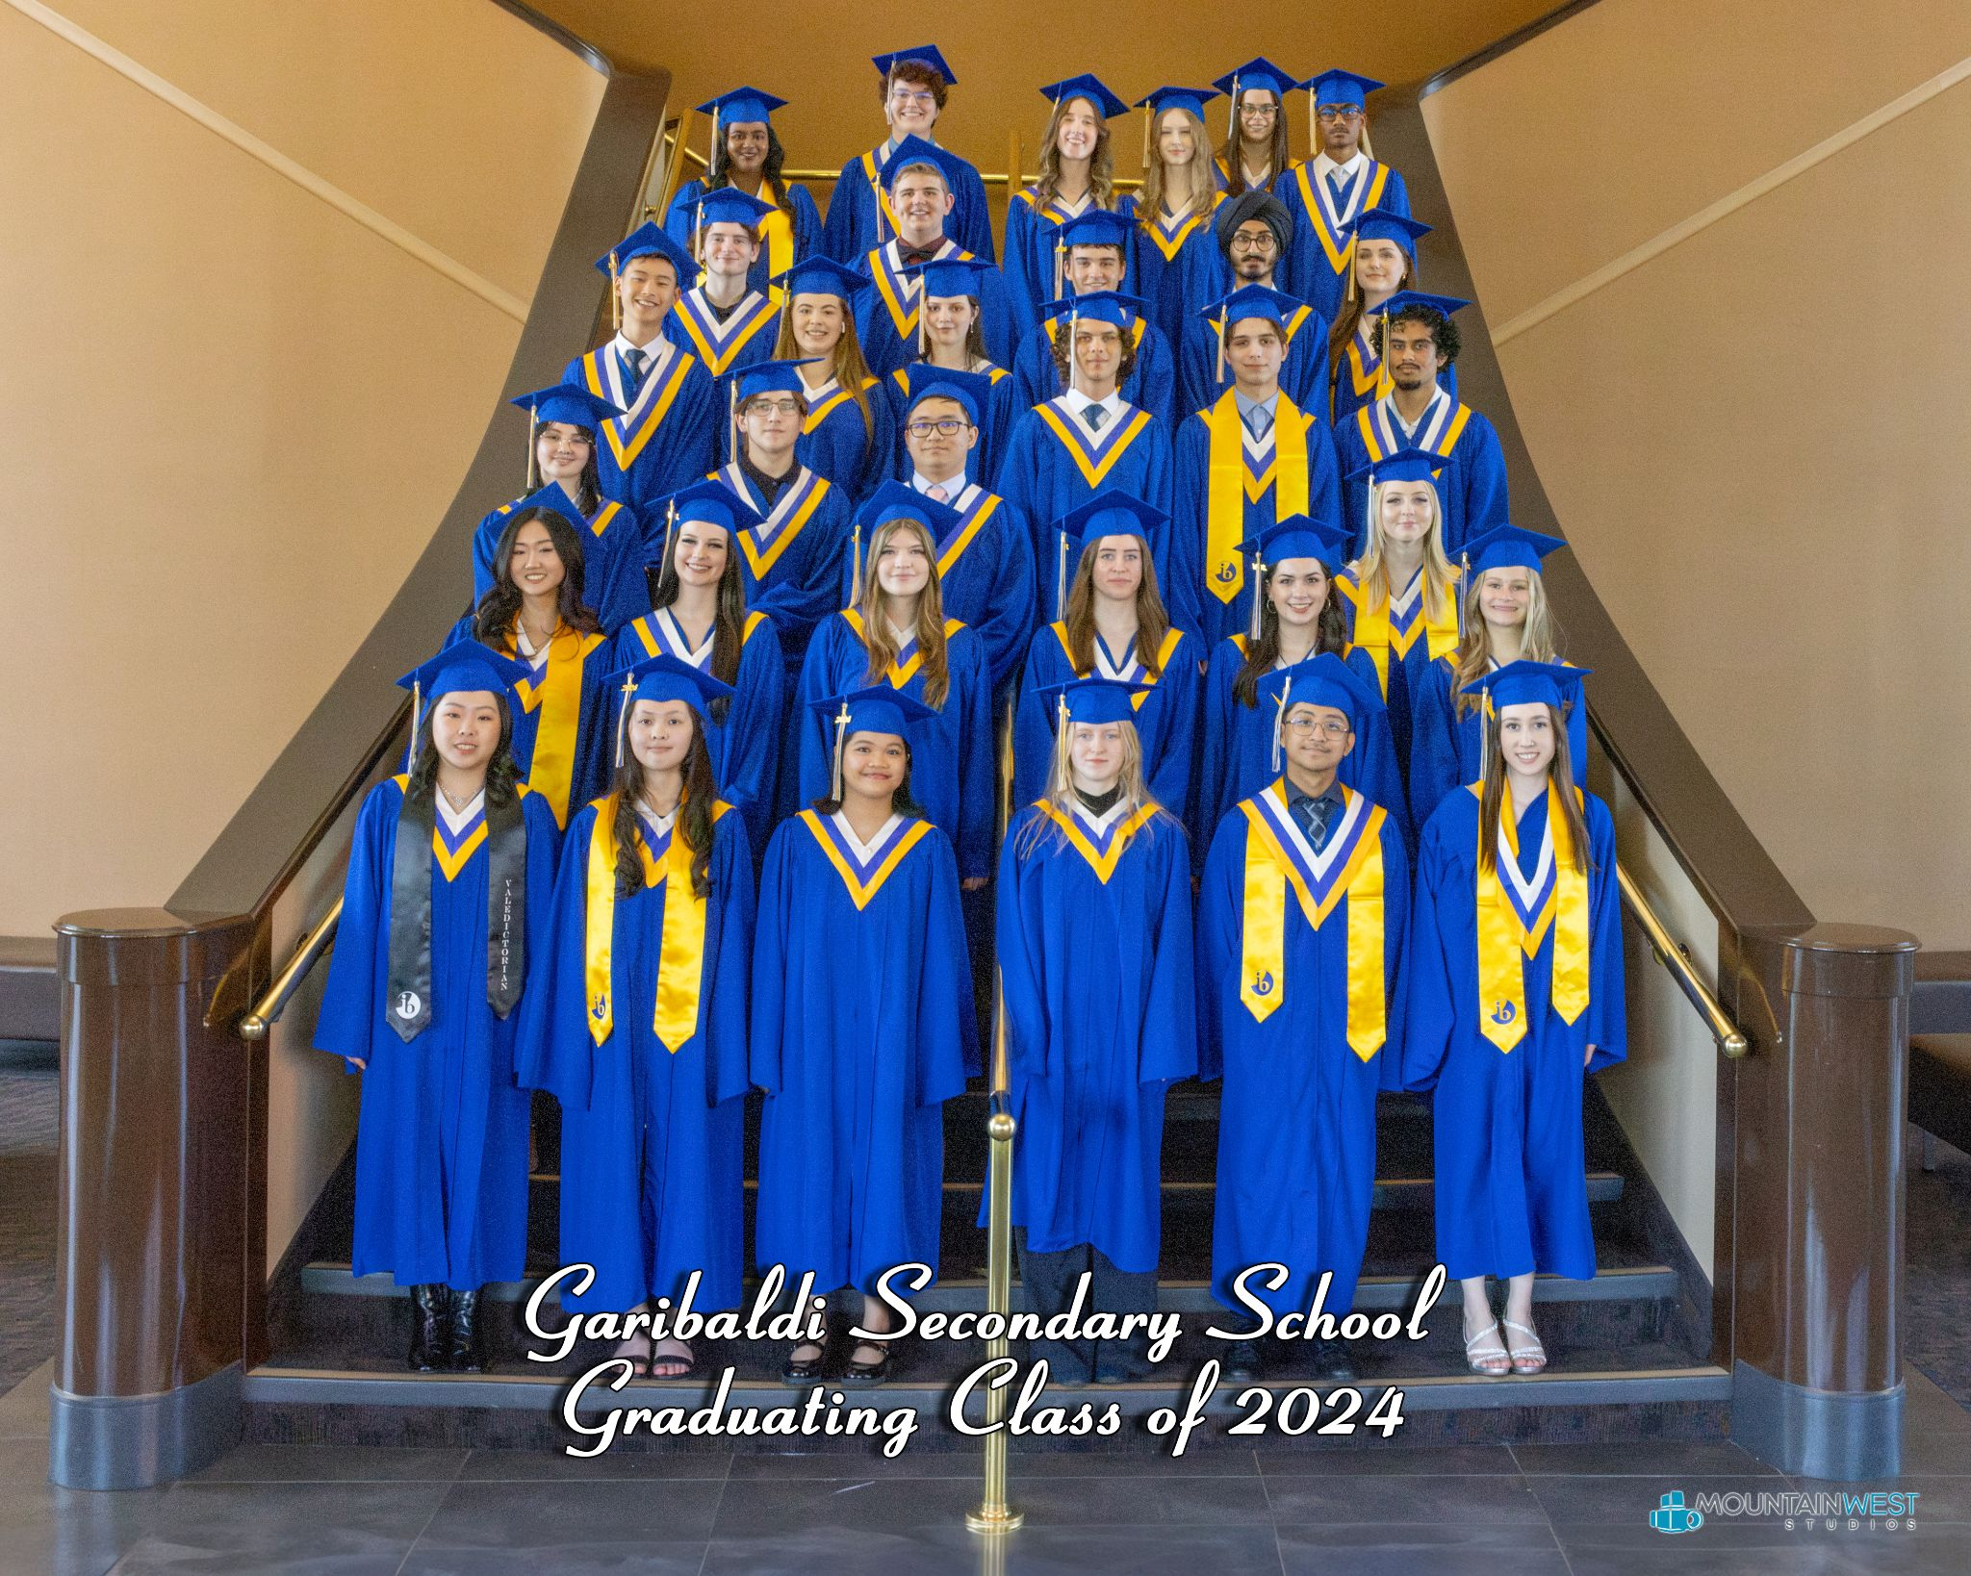
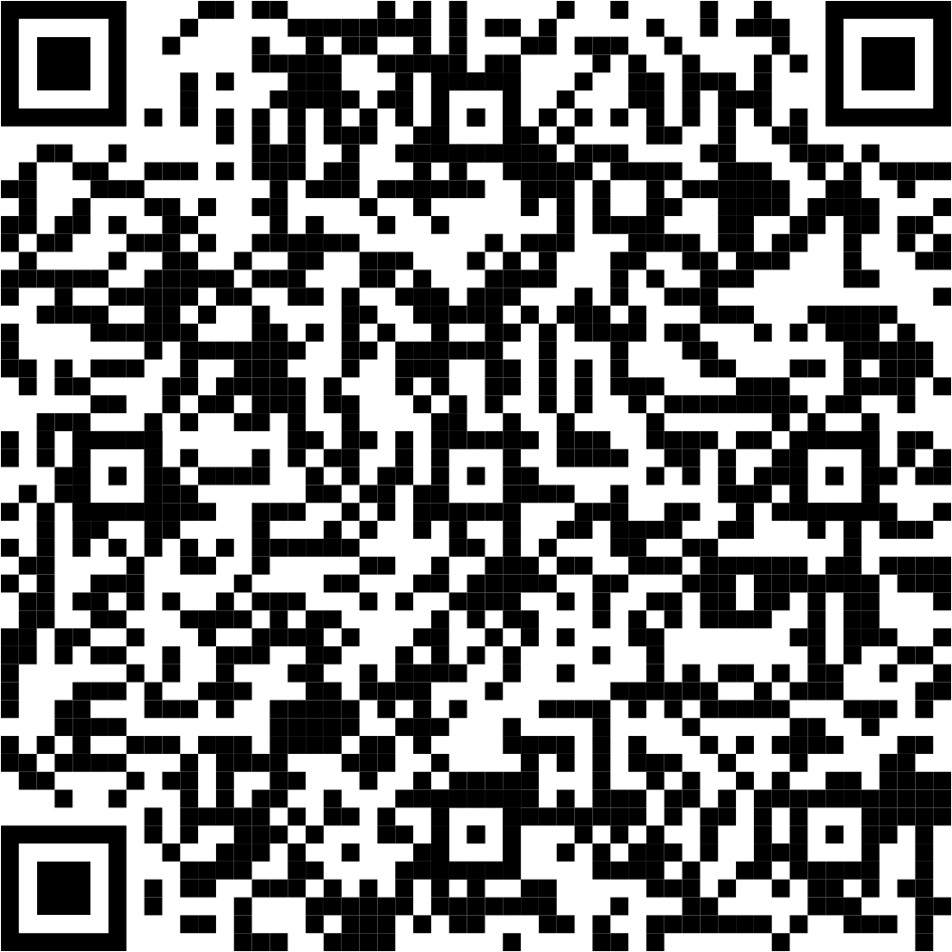
IB Graduates
See more testimonials here: shorturl.at/etKV3
Notes:
Assunta

Slide 44
Garibaldi Secondary
International Baccalaureate
Diploma Programme
Information Night

Slide 45
Notes:
Assunta

Slide 46
Notes:
Assunta

Slide 47
Notes:
Assunta

Slide 48
GSS IB Graduate (2020) Sue Kang
Current SFU undergraduate student
Has had two separate co-ops - working at a Microbiology Lab and the BC Children's Hospital.
Went on exchange to the University of Copenhagen
Published a research paper.

Slide 50
IB Graduate (2021) Siobhan McAleese
Fine Art student at KPU, currently working on animation portfolio for Capilano University.
Was able to apply IB Art credit at KPU and skip Intro to Drawing (went directly to 2nd year course)
IB has helped me build a strong work ethic and to organize my workload to meet deadlines.
Being organized and committed is more important than being "smart" in IB.
Take advantage of GSS IB support network (teachers, students, etc)
Notes:
Assunta

Slide 51
IB Graduate (2021) Rini Liu
First year student at SFU studying Political Sciences for a Bachelor of Arts.
IB helped me in writing assignments in my courses.
develop great organizational and time management skills
transition to University easier due to its workload, reading, note-taking, and exam preparation
Thanks to the many many essays and papers … etc
Notes:
Assunta

Slide 52
IB Graduate (2021) Michael Grundy
Currently studying microbiology and immunology as a first year student at UBC in the faculty of science.
The experience of the IB program helped prepare me greatly for the challenges of university, making the transition into post secondary less stressful.
For example, IB helps develop critical thinking skills and teaches how to manage heavy workloads among many other important skills.
Notes:
Assunta

Slide 53
IB Graduate - Kerem Sahinoglu
BBA, Bachelor of Business Administration in Beedie, SFU. Specializing in Human Resources and Marketing and work in tech or in a medical-related field. I am currently working at CPSBC,
The College of Physicians and Surgeons where I assist the administration department.
My EE allowed me to develop a reading habit. M I find the most important skill gained through IB to be effective
learning and understanding responsibility since this creates a framework for lifelong success.
Notes:
Assunta

Slide 54
IB Career-related Programme (CP)
CP for Culinary Arts with Chef McGimpsey
Students who want participate have the opportunity to be Certified in Level 1 Apprenticeship through ITA in this program and receive a CP Certificate from IB
Similar components to DP Core
Personal, Professional Skills - Culinary Arts
Reflective Project
Service Learning
Language acquisition requirements (does not have to be a full course - 50 hours per year)
Enroll in 2 Diploma Programme courses
2-3 Culinary courses with Chef
Attempt the ITA Level 1 Exam in Spring of Gr. 12

Slide 55
Sample CP Course Schedule
Course 1
IB English
Course 2
IB Art Biology History
Course 3
French
Intro Japanese
Self Study
Course 4
Culinary Arts
Course 5
Culinary Arts
Course 6
Math 11
Course 7
Science 11
Course 8
Elective or
Socials 11

